Slide 1







REST API
Vu Nhat Duy-ITITIU17047

Slide 2


TABLE OF CONTENTS
API
REST API
REST API Methods
DEMO

Slide 3

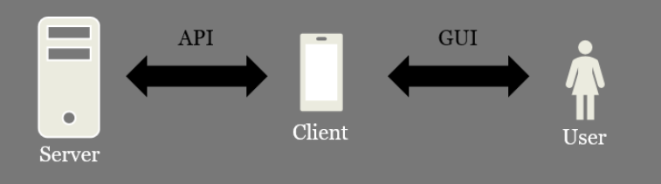

APPLICATION PROGRAMMING INTERFACE
A GUI is an interface for human <> machine communication
An API is an interface for machine <> machine communication .
An API making use of HTTP is called Web API

Slide 4
DIFFERENT TYPES OF APIS
Web APIs
Library APIs
Operating System APIs
Database APIs

Slide 5

2. WHAT IS REST API?
REST (Representational State Transfer):
Architecture style developed by Roy Fielding in 2000.
Contains a set of principles used to design and develop web services.

Slide 6

REST PRINCIPLES
Client-Server Architecture
Stateless Communication
Cacheability
Uniform Interface
Layered System
Code-on-Demand

Slide 7
3. REST API
Use URLs to identify resources
Use HTTP methods to specify operations: POST, GET, PUT, DELETE
Use HTTP headers
Use HTTP status code to indicate success, failure

Slide 8


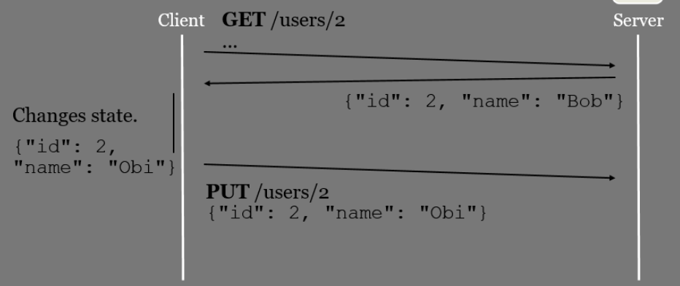
3. THE METHODS
CREATE: POST
RETIREVE: GET
UPDATE: PUT
DELETE: DELETE

Slide 9


REST EXAMPLE
Context: A server with information about users
The GET method is used to retrieve resources
GET /users
GET /users/2
GET /users/2/gender
GET /users/2/name
GET /users?page=1
GET /users?gender=female

Slide 10
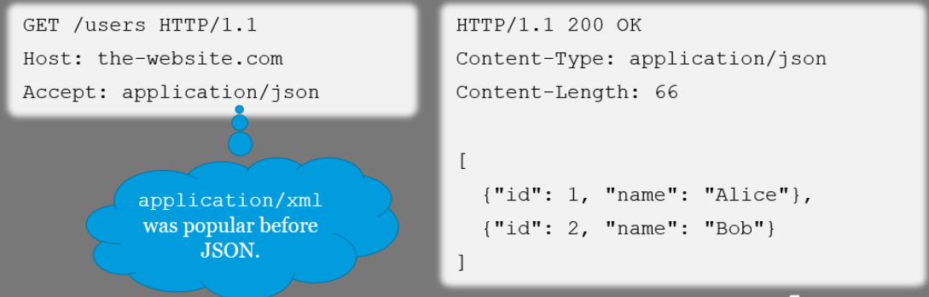
REST EXAMPLE
Context: A server with information about users
The GET method is used to retrieve resources
Which data format? Specified by the Accept header!

Slide 11
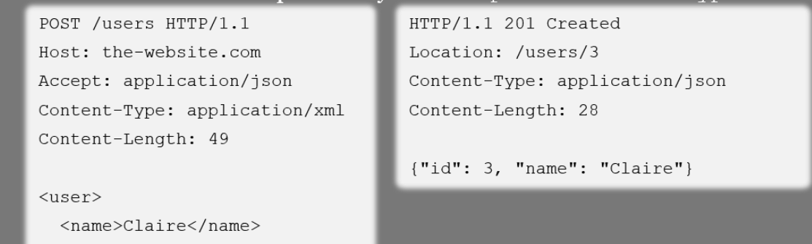
REST EXAMPLE
Context: A server with information about users
The POST method is used to create resources
Which data format? Specified by the Accept and Content-Type header!

Slide 12
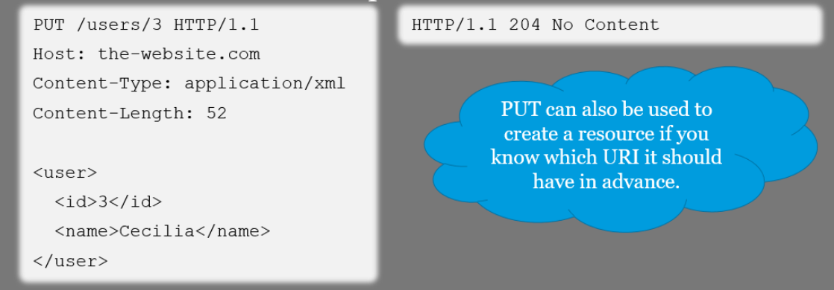
REST EXAMPLE
Context: A server with information about users
The PUT method is used to update an entire resource

Slide 13

REST EXAMPLE
Context: A server with information about users
The DELETE method is used to delete a resource

Slide 14
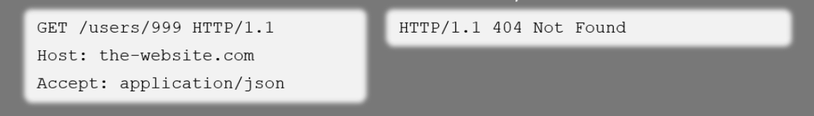
REST EXAMPLE
Context: A server with information about users
What if something goes wrong?
Use the HTTP status codes to indicate success/failure
More information about status codes here:
https://www.restapitutorial.com/httpstatuscodes.html

Slide 15
DEMO

Slide 16


Thank you!
Any questions?

